Slide 1

A GEOSPATIAL AND HYPOTHETICAL ANALYSIS OF CAPITAL BIKESHARE (CaBi)
Tegveer Ghura, Ahmed Khair, Anthony Moubarak, Raghav Sharma, Karan Uppal

Slide 2
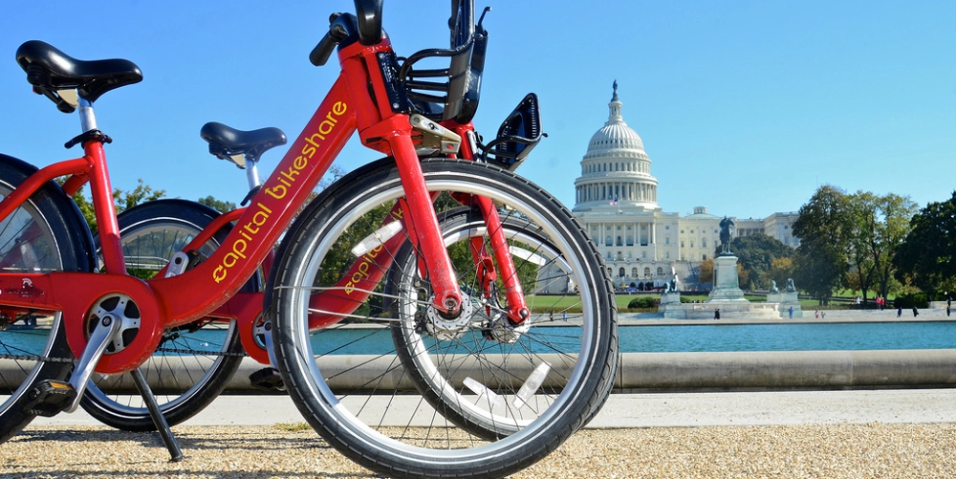
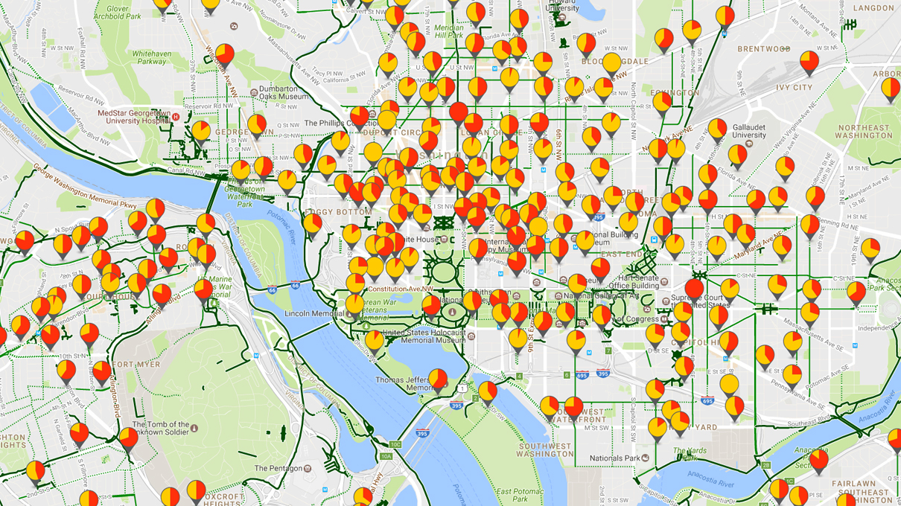
Introduction
Founded in 2010 and serves the Washington DC metro area. CaBi is an alternative method of transportation as it’s cost-effective and environment friendly. Reducing car congestion through DMV investment of $19 million in CaBi to add 80 stations and 3500 electric bikes (Lazo, 2021). In the past, whenever the metro saw reduced service, the DC mayor announced all DC residents could get a free 30 day CaBi membership (Corin, 2021).
Notes:
With rising fuel costs and weather crises, CaBi can be used as an alternative method of transportation as it’s cost-effective and environmentally friendly.
The Bike-sharing segment in the world is projected to grow by 11.48% (2022-2026), resulting in a market volume of US$12.29bn in 2026 (Statista, 2022)

Slide 3
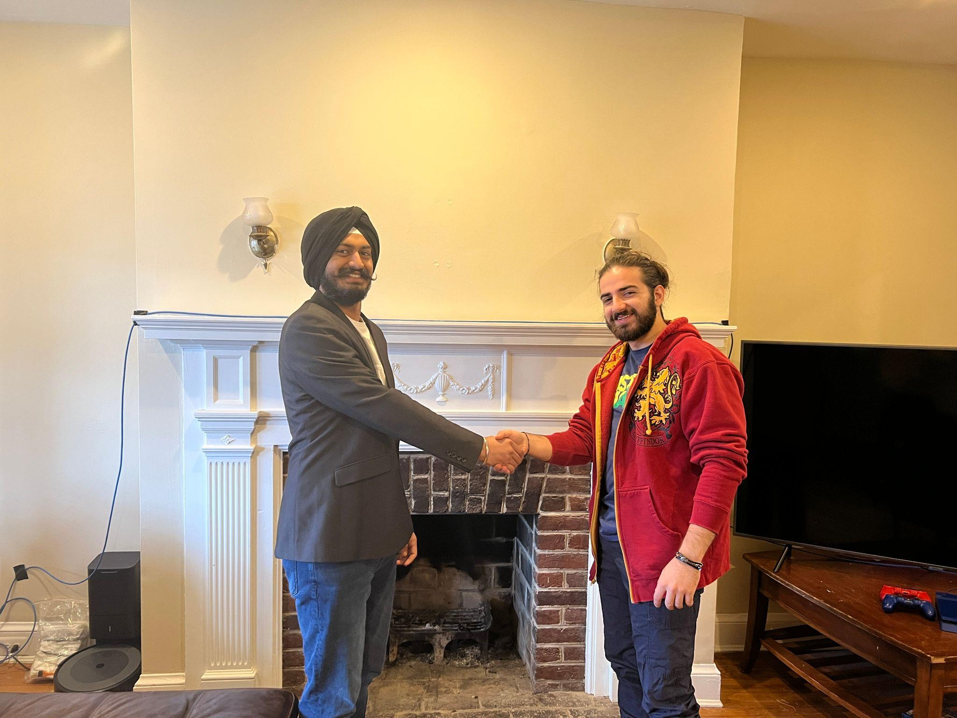
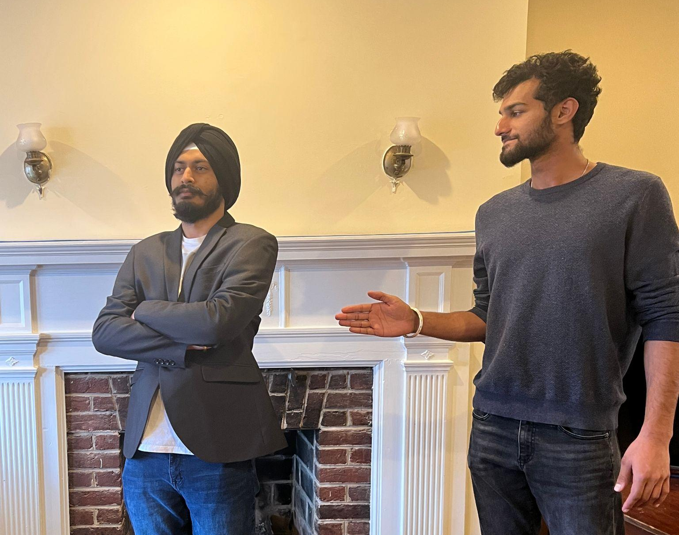
¡STORY!
Anthony (left) is a subscribed member and Karan (right) is a casual rider of Capital Bikeshare bikes. How do their bike-riding experiences differ?

Slide 4
TABLE OF CONTENTS
01
02
03
04
THE DATA
VISUALIZATIONS
Quick overview of population data and important variables
Geospatial maps (exciting!) and miscellaneous plots
CONCLUSION
STATISTICAL RESULTS
Main Takeaways and Bonus Slide
Discussion of Hypothesis Test results and Regression Model

Slide 5
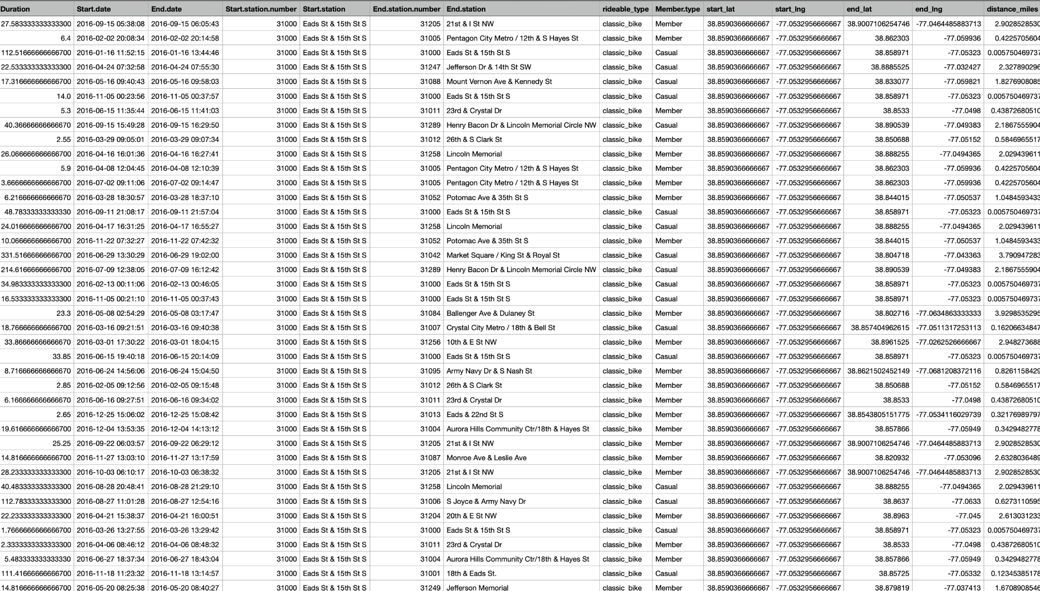
Capital Bikeshare Data
Notes:
This csv represents the capital bikeshare data from 2016 to 2022 collected from CaBi Amazon S3 Bucket
Explain the columns thoroughly
Size of the dataset
removed docked bike (no conclusive info about it)

Slide 6
Capital Bikeshare Data
Key Attribute(s) | Definition
Duration (minutes) | Response Variable present across all years
Start Date and End Date | Start and end date of each trip -> extract date features (hour, month etc)
Start Station # and End Station # | 837 Levels: Station Addresses encoded as ID’s
Bike Type | 3 Levels: Classic or Docked or Electric
Rider Status | 2 Levels: Casual or Member
Start and End Geospatial Coordinates | 2016-2020 March missing these variables -> Data Cleaning and Feature Engineering!
Distance (miles) | Feature engineered using Haversine package
Notes:
This csv represents the capital bikeshare data from 2016 to 2022 collected from CaBi Amazon S3 Bucket
Explain the columns thoroughly
Size of the dataset

Slide 7
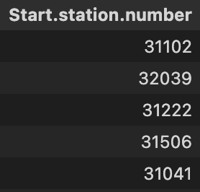
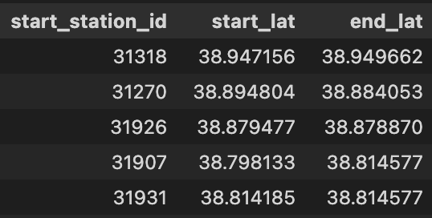
Data Cleaning
Step 1: Dropping and Joining
Dropped NAs and Bike.number column
Append longitude and latitude to datasets that do not have them (2016,2017,2018,2019)
Left join on station number these tables with tables that have longitude and latitude (2020, 2021, 2022)
{
The same was done for all datasets
Notes:
7500+5500+5500+1000+300 = 20000 NA rows dropped out of more than 21 million records
Lat long not present 2016 to 2020 march so join

Slide 8
Data Cleaning
Step 2: Renaming and sampling
Renamed and reordered all columns to have consistency.
Sampled from each dataset to reduce total number of rows.
Sampling process: Using station ID (example below)
Initial Data (3+ million rows)
Sampled Data (300k rows)
Station 1
Station 2
Station 3
20% of entries
50% of entries
30% of entries
Station 1
Station 2
Station 3
20% of entries
50% of entries
30% of entries

Slide 9
Data Cleaning
2131930
Step 3: Merging datasets
Final step was merging all 7 datasets into one dataset
Final dataset has 7 years worth of capital bikeshare rides
Final dataset size: 2,131,930 rows

Slide 10
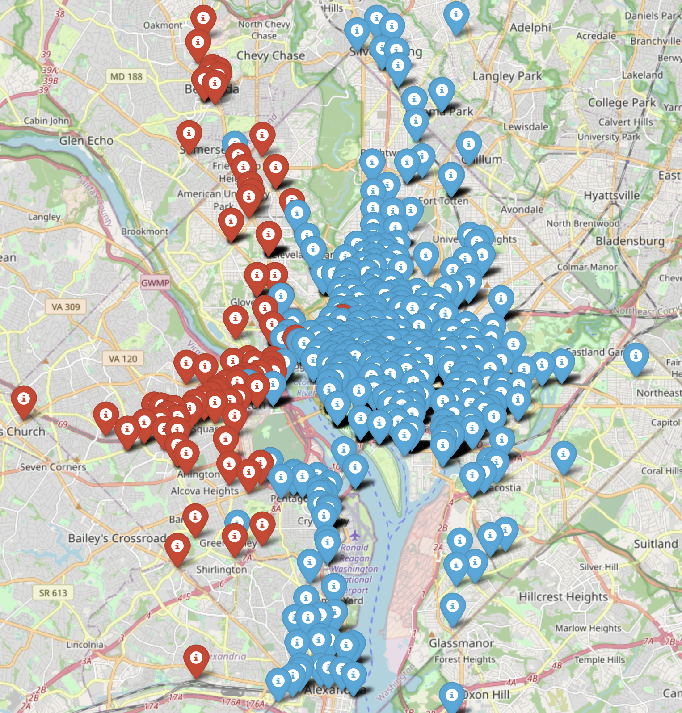
Clustering
2131930
K means clustering was used to avoid using every station id as a variable in the regression model.
Clustering was performed using start and end locations of each ride.

Slide 11
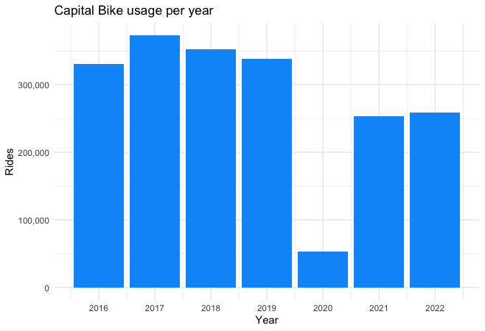
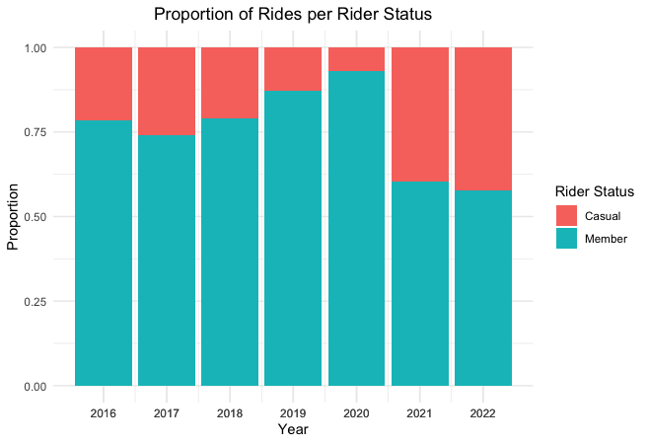
Exploratory Data Analysis
Capital Bikeshare usage over the years
Rider Type distribution over the years
Notes:
Drop in members from 2020 to 2021 by almost (87.5-62.5) 25%! Post covid demand not caught up to pre-covid demand
During covid people stayed and still had membership intact when renewed at the beginning of the year, after covid ended, members did not renew subscriptions!

Slide 12
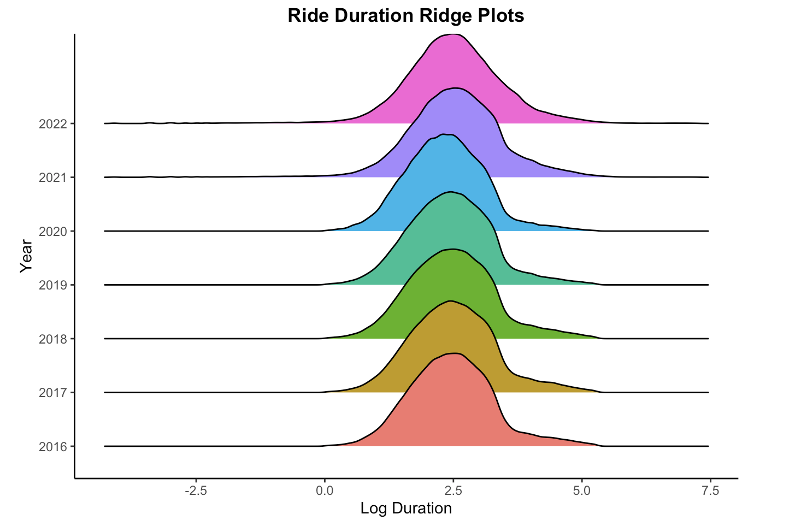
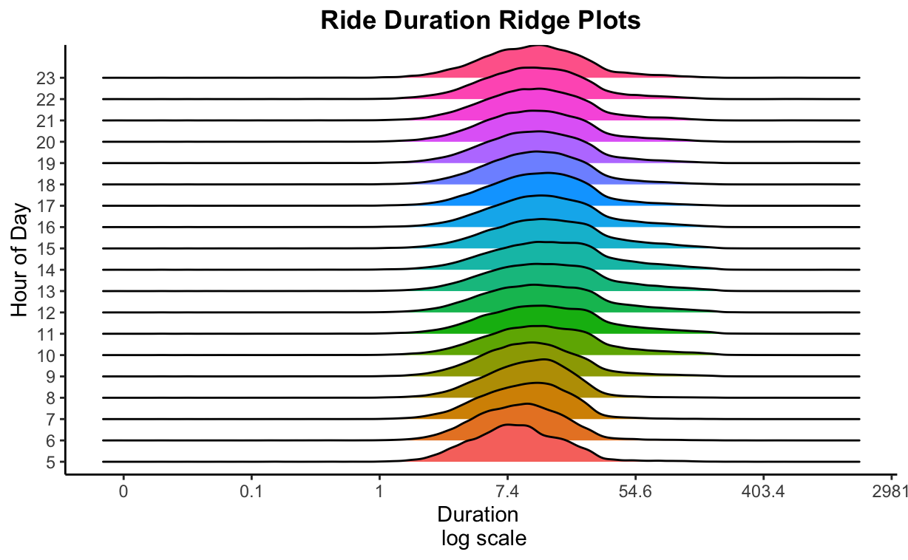
Exploratory Data Analysis
Ride duration distribution per year
Ride duration distribution per hour of day

Slide 13
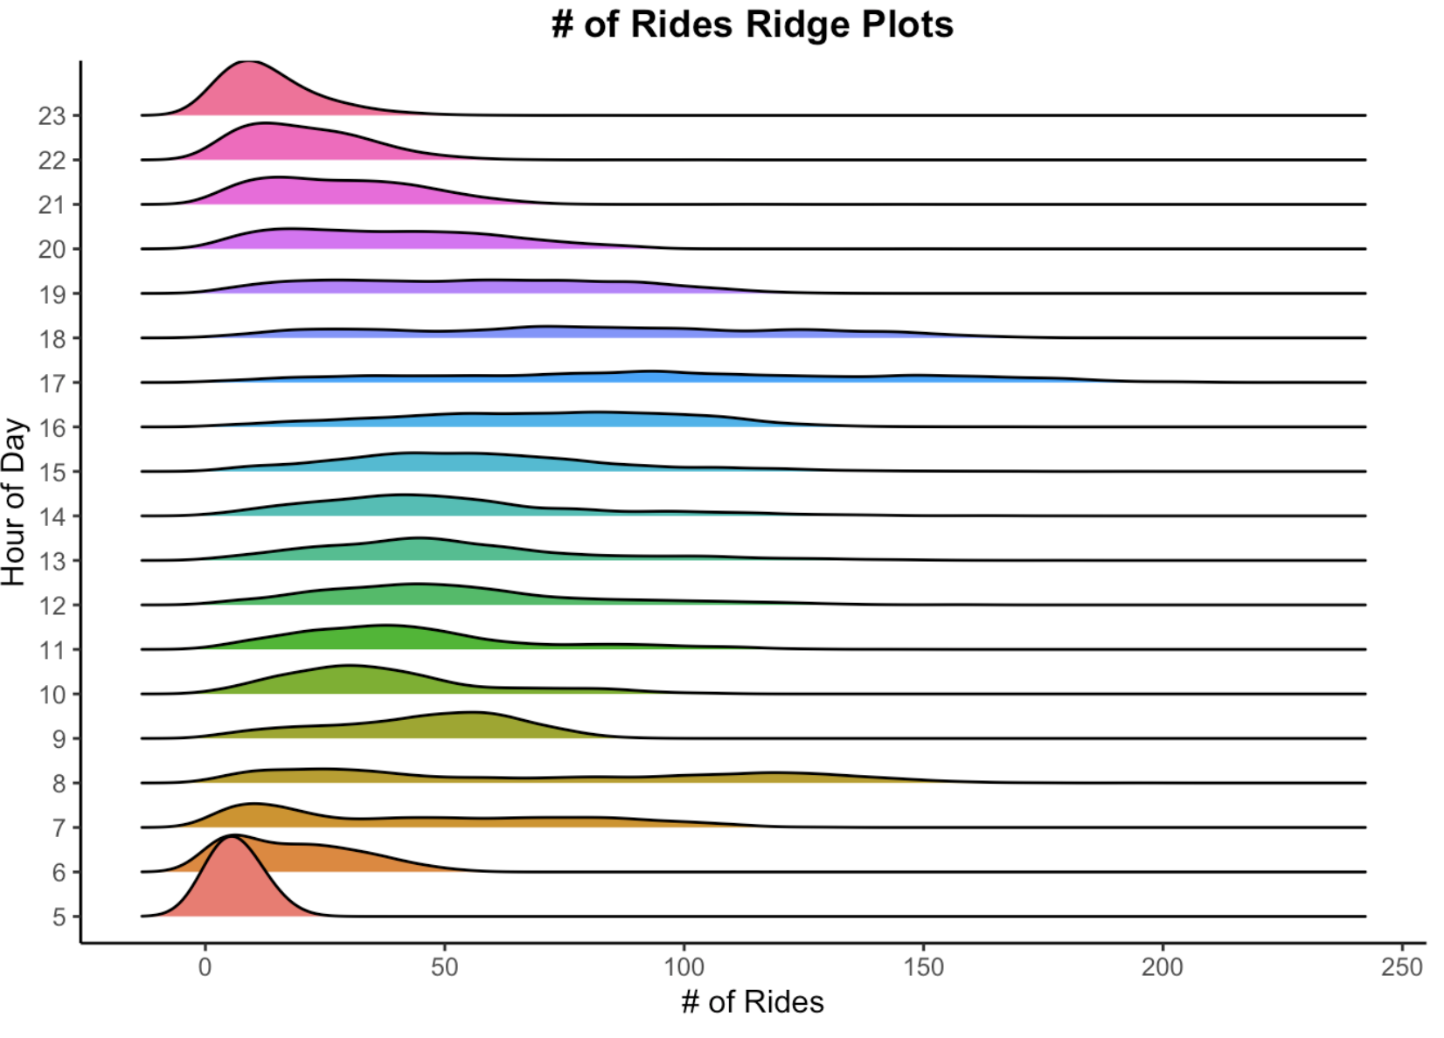
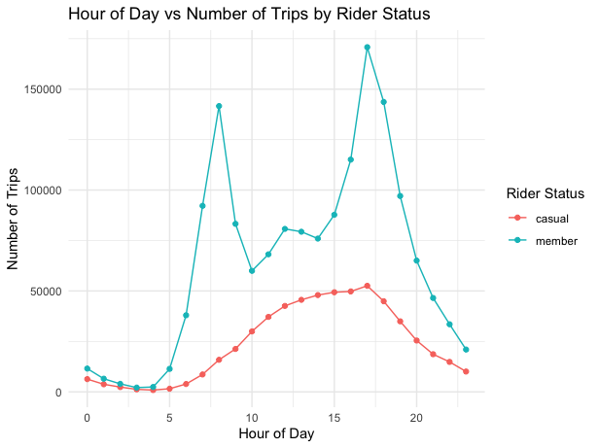
Exploratory Data Analysis
# of start rides distribution per hour of day
# of start rides distribution per hour of day by Rider Status
Notes:
8AM and 5PM are peak hours for CaBi (office in and out) -> distribution more spread out. 175k members starting their trips between 5pm and 6pm (2016-2022)

Slide 14
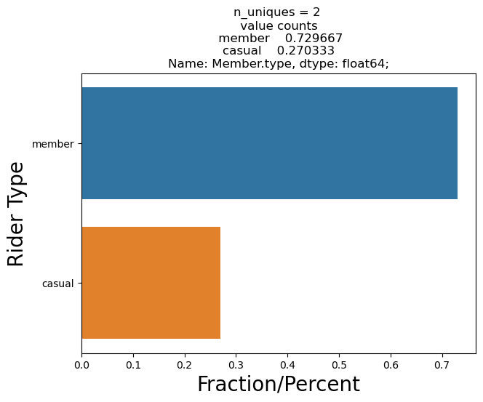
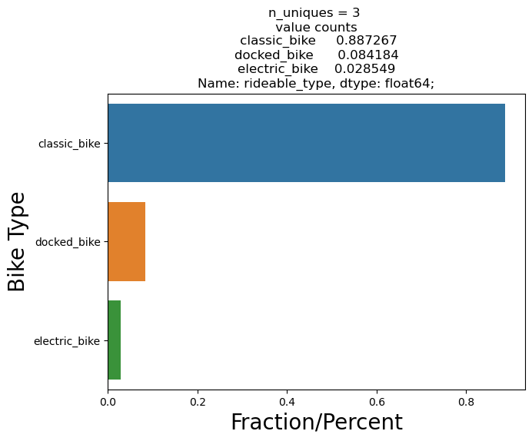
Exploratory Data Analysis
Percentage of Members and Casual Riders (2016-2022)
Percentage of Bikes used (2016-2022)
Notes:
Casual rider: Single Trip plan ($1/unlock and constant price per min) vs member: 24 hr pass or 30 day pass or annual membership ($95 billed upfront! Good for business). Electric bike introduced in 2020 -> low count!

Slide 15
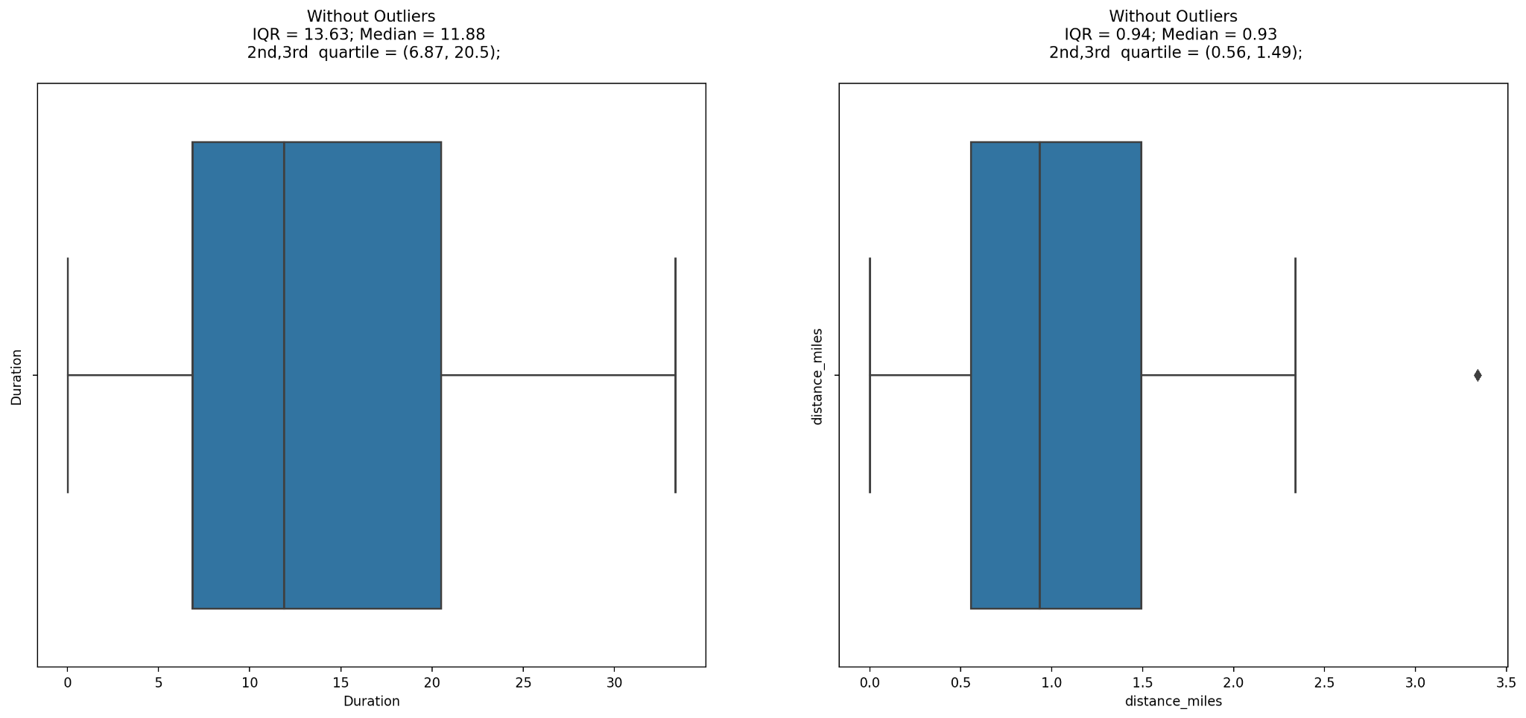
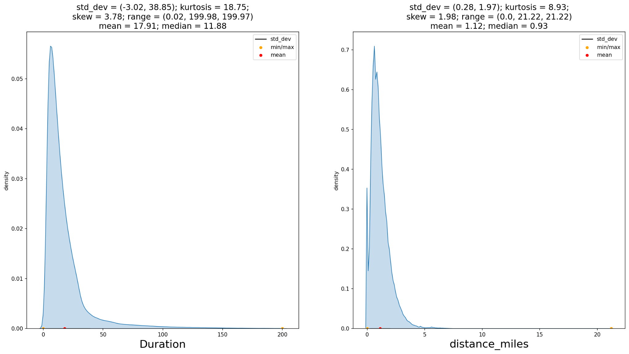
Exploratory Data Analysis
Boxplot for duration of Bikes used and distance of miles traveled (2016-2022)
Distributions for duration of Bikes used and distance of miles traveled (2016-2022)

Slide 16
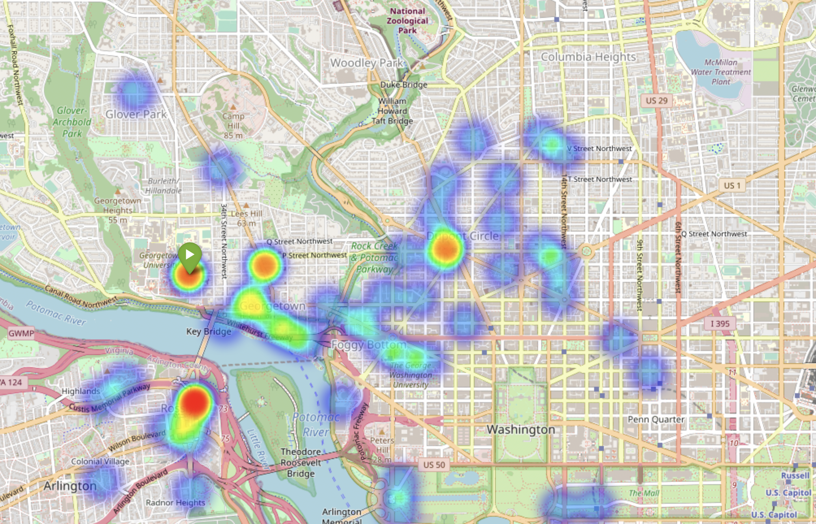
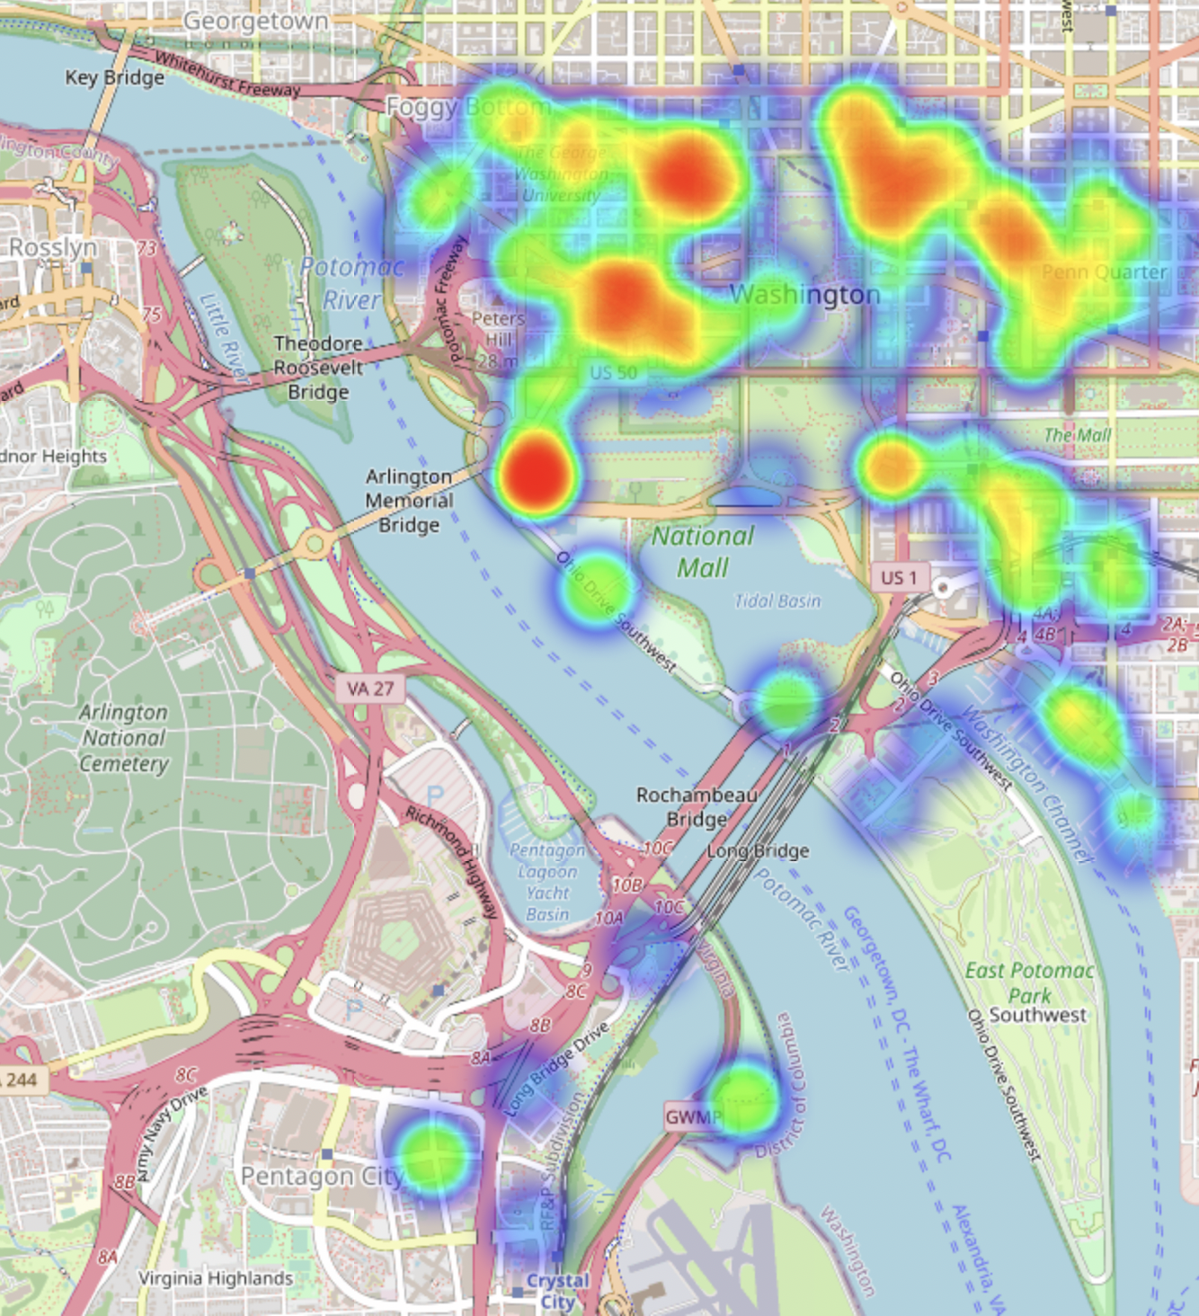
Geospatial Plots (EDA)
End Stations for trips starting from Georgetown University (37th & O St NW)
End Stations for trips starting from Mass Ave & Dupont Circle

Slide 17
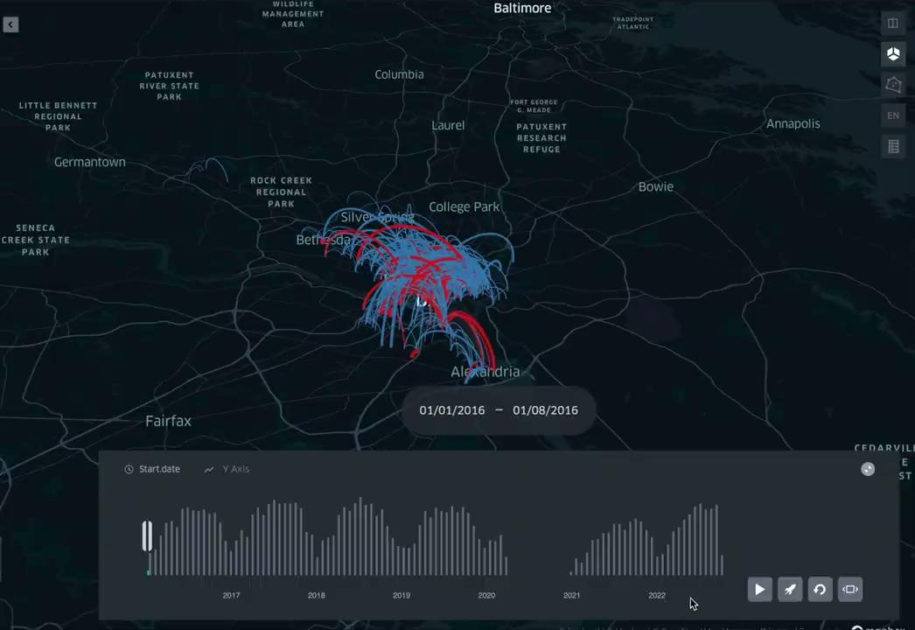

Start and End Trips Time-Series Geospatial Visualization
(2016-2022)
n
Notes:
open source geospatial analysis tool

Slide 18
HYPOTHESIS TESTS
Types of tests used
01
02
03
04
Chi-Squared
Bootstrap
Two Sample t-Test
Bike type and distance travelled (miles)
Bike type and membership type
Membership status and ride duration
Bike type and ride duration
Two Sample t-Test

Slide 19
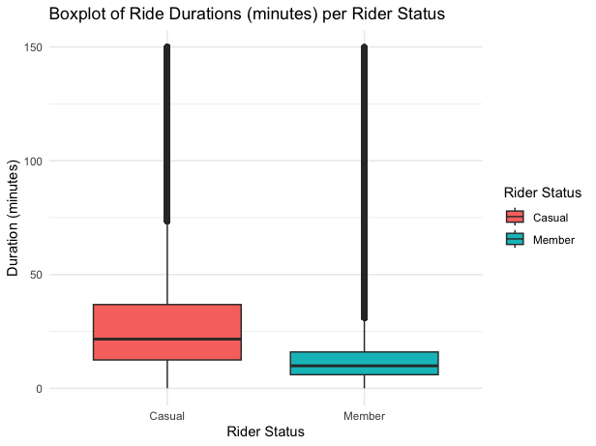
Membership Status vs Ride Duration
Two Sample t-Test
H₀: The mean trip duration of
casual riders is the same as that of members across 2016-2022
H_{a}: The mean trip duration of
casual riders is more than that of members across 2016-2022

Slide 20
Membership Status vs Ride Duration
P-Value | 95% Confidence Interval: Lower Bound | 95% Confidence Interval: Upper Bound | Mean Trip Duration of Casual Riders across 2016-2022 | Mean Trip Duration of Members across 2016-2022
< 2.2 x 10⁻¹⁶* | 17.8. minutes |  | 30.4 minutes | 12.6 minutes
∞
*p < 0.05 → Reject H₀ and conclude that Mean trip duration of casual riders > Mean trip duration of members

Slide 21
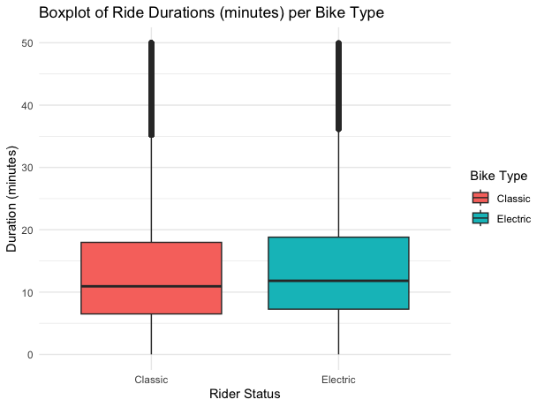
Bike Type vs Ride Duration
Two Sample t-Test
H₀: The mean trip duration of
rides on classic bikes is the same as that of rides on electric bikes
H_{a}: The mean trip duration of
rides on a classic bike is different than that of rides on electric bikes

Slide 22
Bike Type vs Ride Duration
P-Value | 95% Confidence Interval: Lower Bound | 95% Confidence Interval: Upper Bound | Mean Trip Duration of Rides Completed on Classic Bikes across 2016-2022 | Mean Trip Duration of Rides Completed on Electric Bikes across 2016-2022
1.2 x 10⁻⁸* | - ∞ | -0.26 | 16.54 minutes | 16.92 minutes
*p < 0.05 → Reject H₀ and conclude that Mean trip duration on electric bikes > Mean trip duration on classic bikes

Slide 23
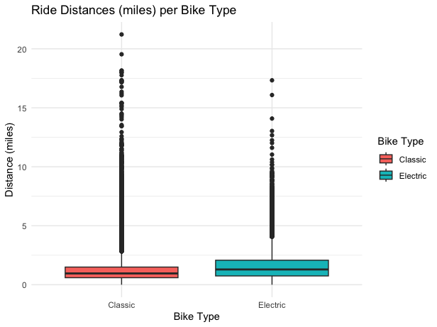
Bike Type vs Distance Travelled
Bootstrap Testing
H₀: The mean distance
covered per trip on classic bikes is the same that on electric bikes.
H₁: The mean distance covered
per trip on classic bikes is different than that on electric bikes.

Slide 24
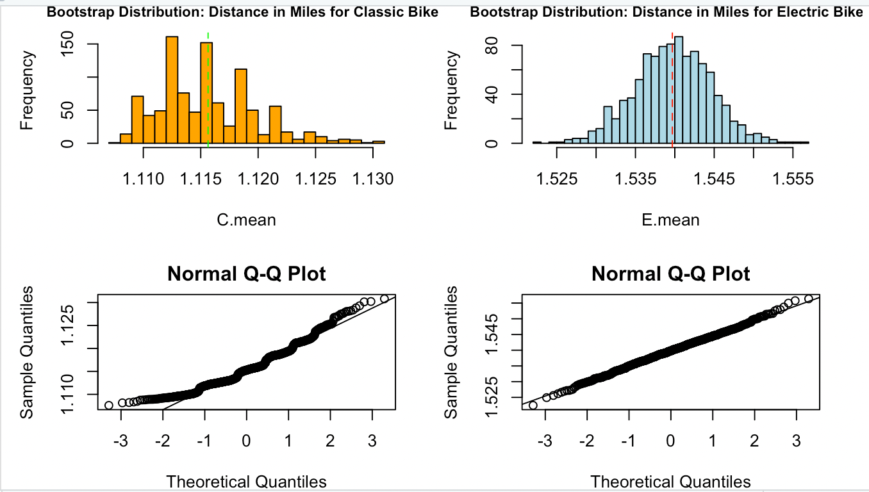
Bike Type vs Distance Travelled
95% Confidence Interval (Difference in Means): Lower Bound | 95% Confidence Interval (Difference in Means): Upper Bound
0.41 | 0.44
0 not in Interval→ Reject H₀ and conclude that Mean distance traveled on electric bikes > Mean distance traveled on classic bikes

Slide 25
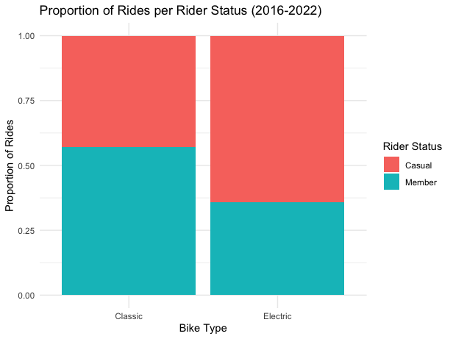
Bike Type vs Rider Status
Chi squared test
H₀: Bike rider status and
bike type used are independent
H_{a}: Bike rider status and
bike type used are dependent

Slide 26
Bike Type vs Rider Status
Two-Way Table (Bike Type vs Rider Status) | Casual | Member
Classic Bike | 440,846 | 1,428,789
Electric Bike | 25,592 | 34,566
Dropped docked bike type
*p < 0.05 → Reject H0 and conclude that Bike Type and Rider Status are dependent

Slide 27
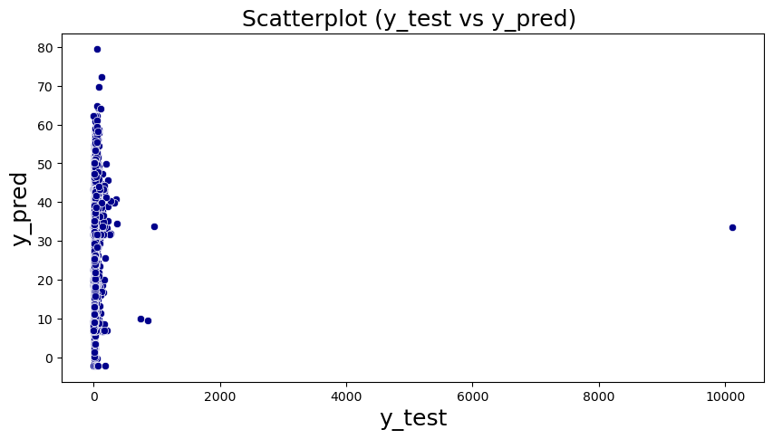
Regression Model
Mean absolute error = 14.8
Mean squared error = 25133.51
Median absolute error = 4.97
Explain variance score = 0.01
R2 score = 0.01
Notes:
Grid search CV and RepeatedKfold
Fit intercept

Slide 28
Conclusions
Main Takeaways:
Karan, on average, spends more time riding the bikes than Anthony does.
Across all members, time spent and distance travelled riding electric bikes > time spent and distance travelled riding classic bikes
Since type of bike used is dependent on membership status, Anthony prefers riding electric bikes more than Karan does (and it is cheaper for Anthony!)
Our dataset is more conducive for Logistic Regression or Classification Modeling (more in ANLY 512!)
!
Notes:
Regression Model (Data from 2016-2022):
The Regression model created by clustering the data based on location and predicting the trip duration was inconclusive including parameters such as membership type and bike type.

Slide 29
References
Capital Bikeshare System Data. Accessed November 7, 2022. https://s3.amazonaws.com/capitalbikeshare-data/index.html.
“Capital Bikeshare Development Plan Update .” The District Department of Transportation, December 5, 2022. https://ddot.dc.gov/.
“Are You Getting the Most for Your Money from Capital Bikeshare?” WAMU, October 22, 2013. https://wamu.org/story/13/10/21/are_you_getting_the_most_for_your_money_from_capital_bikeshare/.
Corin, C. (2021, October 25). Mayor Bowser and Lyft Announce Free Capital Bikeshare memberships for all DC residents. DC News Now Washington, DC. Retrieved December 7, 2022, from https://www.dcnewsnow.com/news/local-news/washington-dc/mayor-bowser-and-lyft-announce-free-capital-bikeshare-memberships-for-all-dc-residents/
Lazo, Luz. “Meet the Capital Bikeshare Rider Who Visited All 683 Stations.” The Washington Post. WP Company, May 1, 2022. https://www.washingtonpost.com/transportation/2022/04/29/capital-bikeshare-top-rider/.
Lazo, L. (2021, October 16). D.C. wants you to ride bikes. This month it raised the cost to Ride Capital Bikeshare. The Washington Post. Retrieved December 7, 2022, from https://www.washingtonpost.com/transportation/2021/10/16/dc-capital-bikeshare-fee-increase/
Statista. (2022). Bike-sharing - worldwide. Statista. Retrieved December 7, 2022, from https://www.statista.com/outlook/mmo/shared-mobility/shared-rides/bike-sharing/worldwide

Slide 30
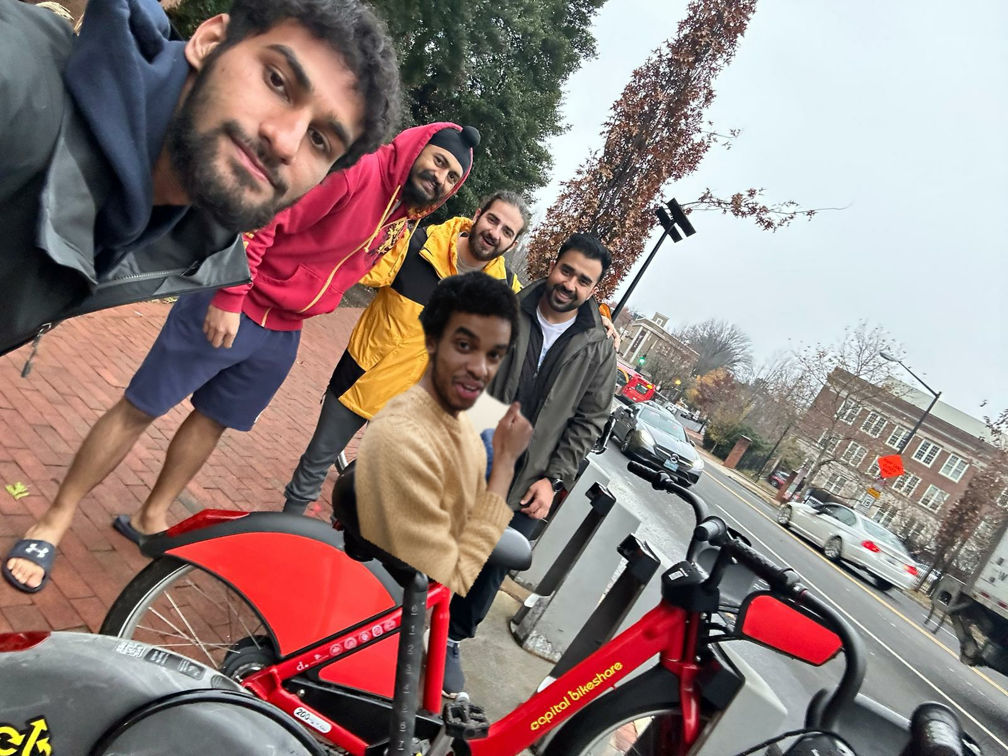
Bonus Content
Happy CaBi members (thanks for the Discount Georgetown University)!
Notes:
After listening to this presentation, Karan has finally made up his mind to utilize CaBi as an annual member. Ahmed’s the happiest!

